Slide 1


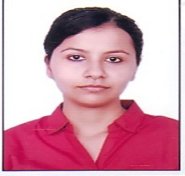
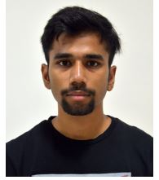
PID-235 Road Surface Analysis and Potholes Detection
Full Paper Presentation on
Author Names and Photos:
Photo (Author 1)
Akanksha Dwivedi
Ayush Singhal
Notes:
Title Text Font Calibri Body Bold, Font Size 34, Name and Designation Font Size 18

Slide 2

Index
Challenge Statement
7
Implementation/ Proto/POC
Concept /Scope of Solution
8
Validation / Testing / Analysis
3
Pros and Cons of the solution
9
Cost /Benefit
4
Detailed Description
10
Results and potential Business Impact for L&T TS
5
Technology /background
11
Conclusion
6
Development Procedure / Methodology
12
References

Slide 3
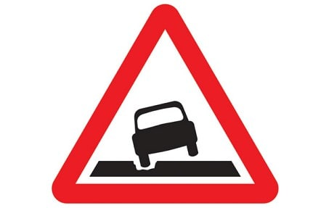
Challenge Statement
Automatic perception of road surface and potholes detection

Slide 4
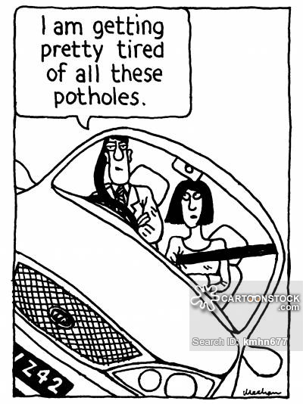
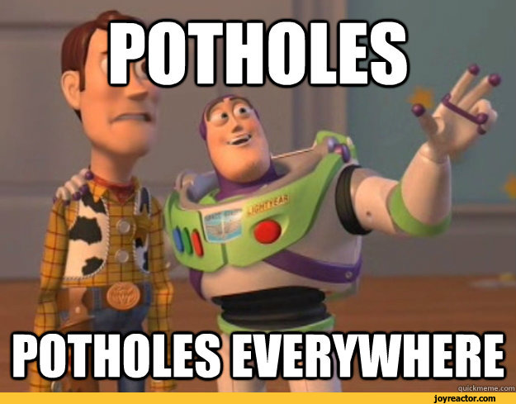
Concept / Scope of solution
To develop a system which can predict potholes/manholes .
To automatically analyze and classify different road surfaces.
To make the system learn the current terrain and predict the imminent potholes.
To provide terrain description and safe navigation.
To ensure road safety .

Slide 5
Pros and Challenges of the solution
Pros :
It would enable the drivers to make informed decisions while driving, avoiding the irregular road surface/potholes .
It would lead to increase in fuel efficiency and longevity of the tires.
It would lead to significant decrease in road congestion.
Challenges :
To make the driver aware of these irregularities in advance instead at that exact moment.
Prediction of the potholes is difficult if the vehicle is moving at high speeds.

Slide 6
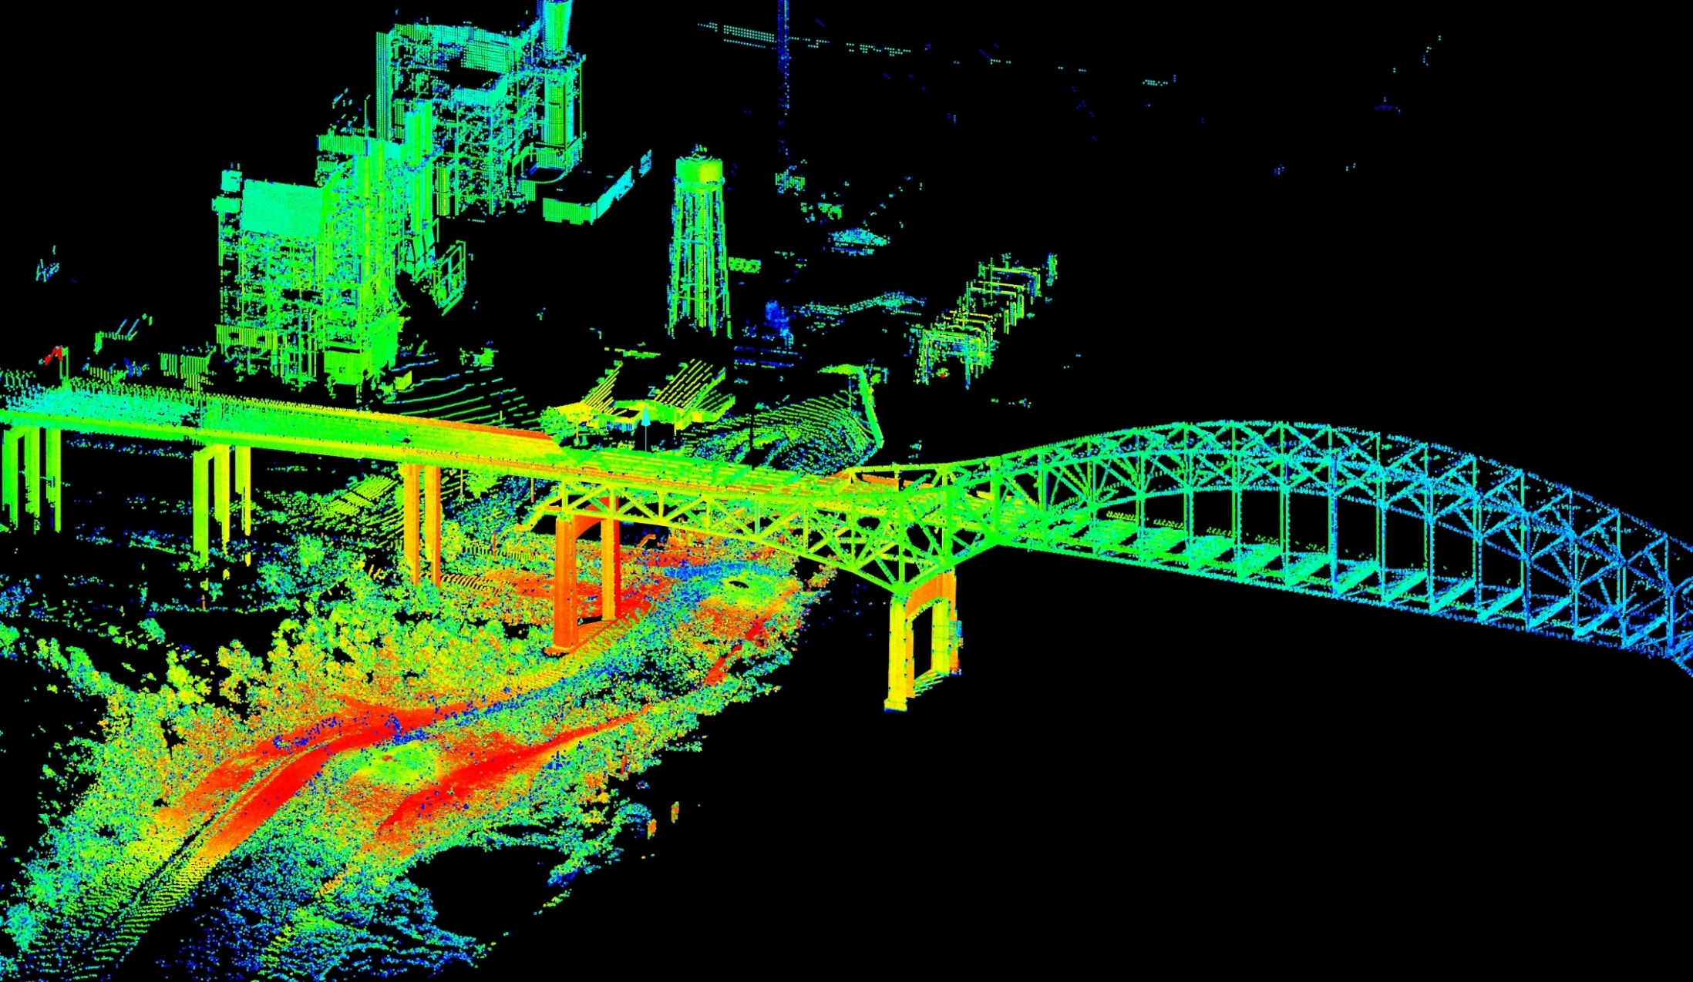
Detailed Description
We will combine the data from two sources:
LIDAR (Light Detection and Ranging) sensors : It is a remote sensing technology that measures the distance by illuminating a target (potholes/manholes) with a laser.
Microsoft Kinect/Depth Sensor : An infrared projector and a monochrome CMOS sensor work together to see the frontal view of the road in 3D regardless of the lighting conditions.
Input from both of these sensors would be processed with edge detection and gradient image processing techniques, which give edges, and gradients along horizontal and vertical directions, respectively. The resultant feature vectors, obtained from these techniques, will be fed to a PCA (Principal Component Analysis) to reduce the dimension of feature space.
The final feature vectors would be input to classification machine learning algorithm (kNN , SVM) which would notify whether we should continue moving in the same direction or change lanes.

Slide 7

Technology/Background
Open CV
Prewitt/Sobel Gradient Detection Algorithms
Sobel/Canny Edge detection Algorithms
MATLAB
Principal Component Analysis Algorithm (PCA)
K-Nearest Neighbor(kNN), Support Vector Machines(SVM) classification algorithms

Slide 8
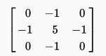
Development Procedure/Methodology
Capture training data of four classes of roads i.e. with/without potholes
and with/without irregularities on road surfaces using LIDAR and Kinect Depth Sensors.
Divide the collected dataset as follows: 60% as training data, 20% as cross validation data
and 20 % as testing data.
Apply Gaussian Blur to input images to perform smoothening of the image and filter out the noise.
Convolve the input with the sharpening kernel to sharpen the edges in the input.
Extract out the feature vectors, from the output of pre-processing techniques, using Gradient and Edge Detection algorithms.
Employ Principal Component Analysis(PCA) to reduce the dimension space of the feature set extracted.

Slide 9
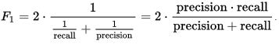
Development Procedure/Methodology
Train the classification model and estimate the model parameters using k-Nearest Neighbor (kNN) or Support Vector Machines(SVM) classification algorithms.
Validate the model’s accuracy by calculating F1-score statistic.
where Precision measures the positive predictive value and Recall measures the sensitivity in the data.
Predict using the above built model whether or not to stay in the same lane and store these results on the cloud server, for future references.

Slide 10
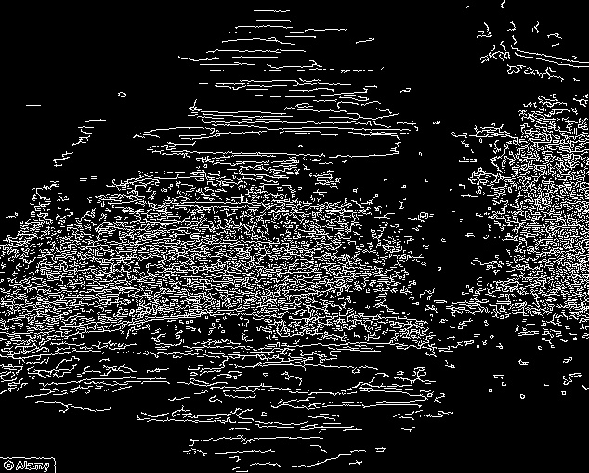
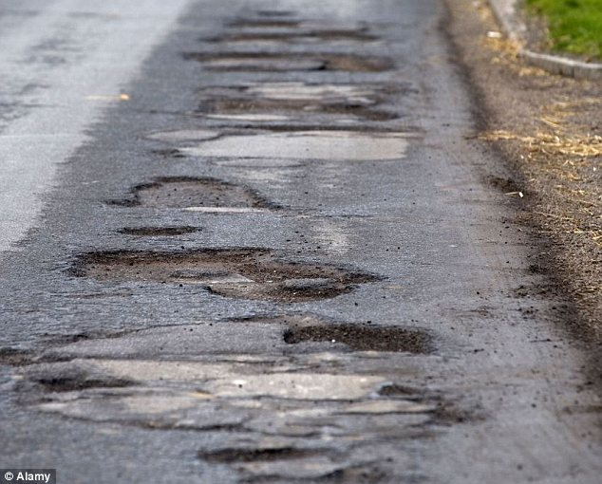
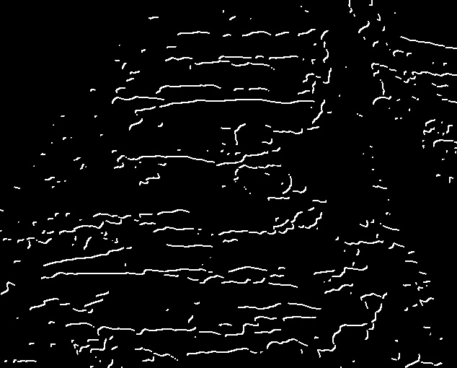
Implementation and prototype / POC
MATLAB : Gradient
Original Image
OPEN CV : Adding horizontal
and vertical Gradients

Slide 11
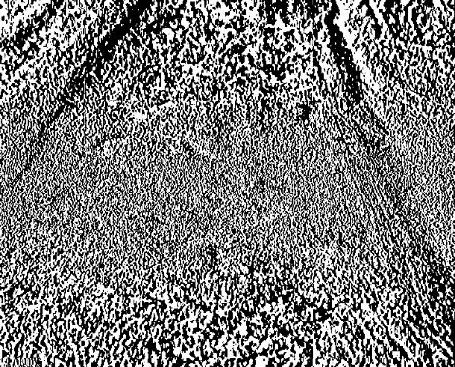
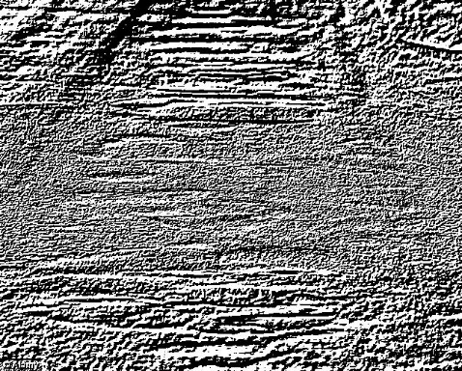
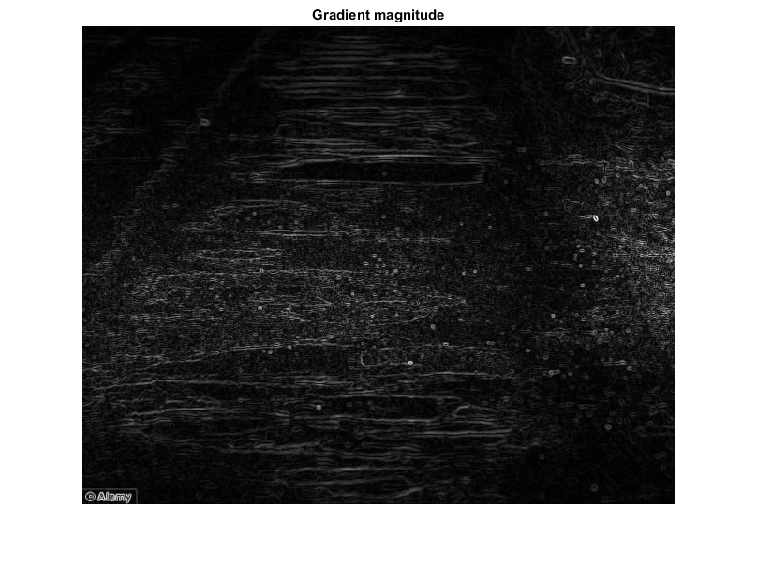
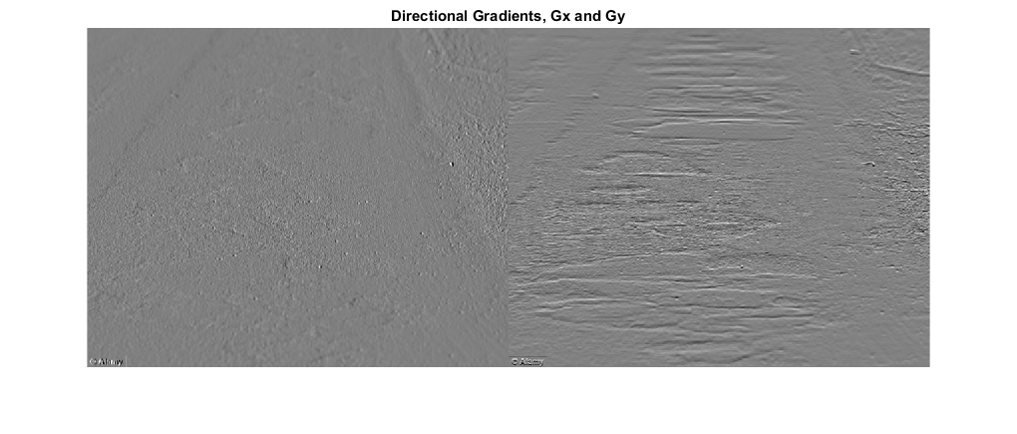
Implementation and prototype / POC
Gradient along Y axis
Original Image
Gradient along X axis
Directional Gradients, Gx and Gy
Gradient Magnitutde

Slide 12
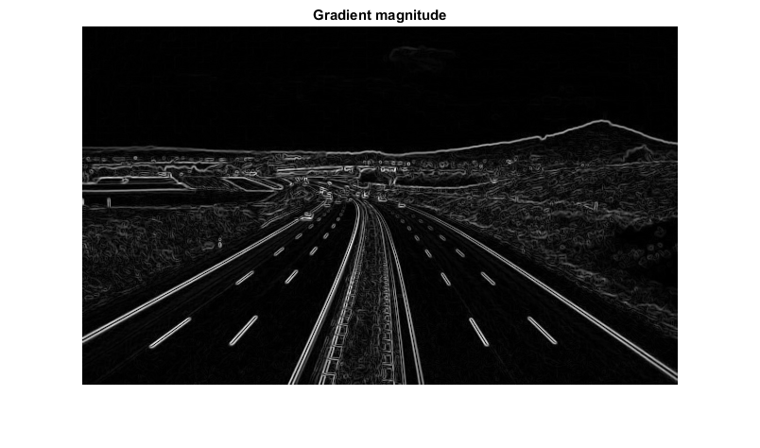
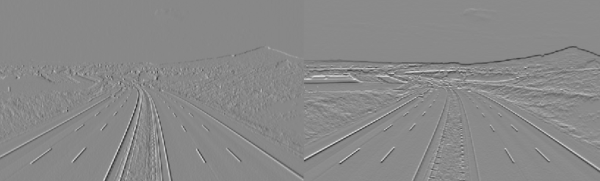
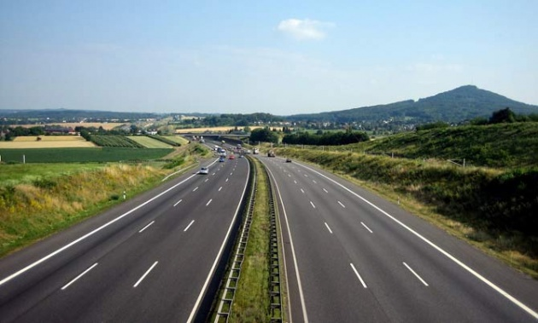
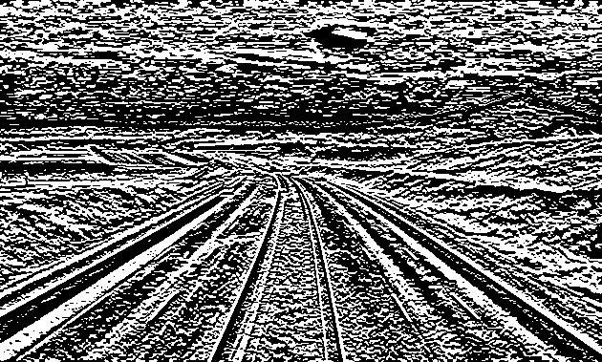
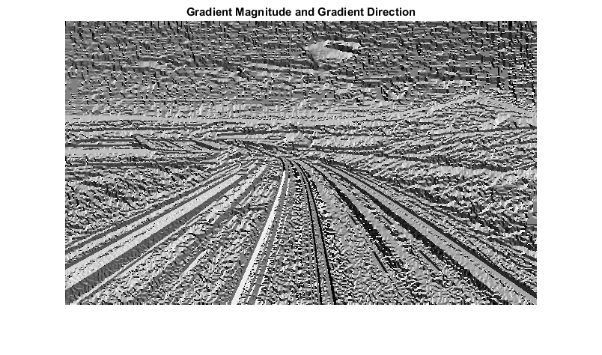
Gradient Magnitude
Directional Gradients, Gx and Gy
Original image
Gradient along X axis
Gradient along Y axis

Slide 13
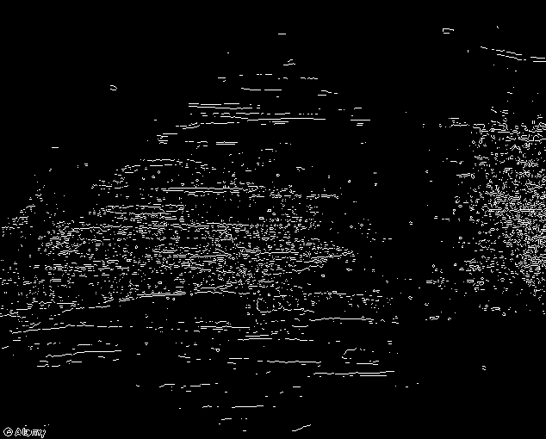
Implementation and prototype / POC
Canny Edge Detection
Sobel Edge Detection

Slide 14
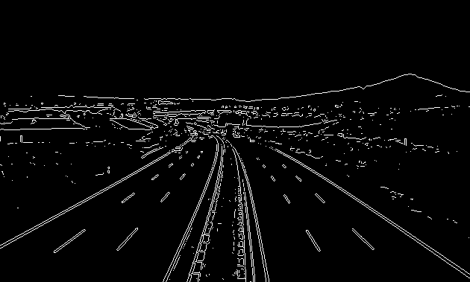
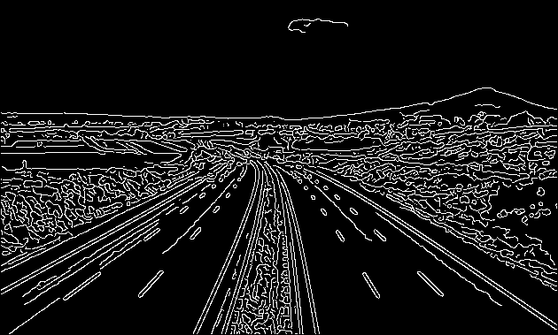
Implementation and prototype / POC
Sobel Edge Detection
Canny Edge Detection

Slide 15
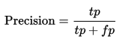
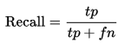
Validation / Testing / Analysis
VALIDATION-
Cross-Validation data is used to predict whether the cross validating data is fitting the model trained, properly.
The goal of cross validation is to give an insight on how the model will generalize to
an independent dataset/an unknown dataset.
Note that we have selected 20% of the dataset as cross validation data.
TESTING-
A test set is a set of data used to assess the strength and utility of a predictive relationship.
We have selected 20% of the dataset as test data set.
Mean F Score. The F1 score, commonly used in information retrieval,
measures accuracy using the statistics precision p and recall r. True Positives are denoted by tp , False Positives
are denoted by fp and False Negatives are denoted by fn .

Slide 16
Validation / Testing / Analysis
ANALYSIS-
Analysis of variance (ANOVA) is a collection of statistical models
used to analyze the differences among group means and their associated procedures
(such as "variation" among and between groups. In the ANOVA setting, the observed variance in a particular variable is partitioned into components attributable to different sources of variation.
We have used ANOVA to analyze if the top directions with maximum variance, predicted with PCA, are not redundant.

Slide 17
Cost /benefits
COMPONENTS | COST IN INR | COST IN USD
OPENCV (WINDOWS/LINUX/MAC-OS) | Open Source | Open Source
MATLAB | 1,45,000 | 2000
LIDAR MODULE | 12,500 | 150
KINECT DEPTH SENSOR | 10,440 | 150
TOTAL DEVELOPMENT TIME- 4-6 Months
COST PER MODULE - 400 USD

Slide 18
Results and potential Business Impact for L&T TS
L&T IDPL -Bridges and Road Infrastructure
It would be easier to detect irregular road surfaces/potholes which would cut down the time required to repair and maintain the infrastructure.
LNTECC Smart Infrastructure
Tracking the infrastructure would be easier, which would contribute towards the idea of “Smart Cities” and “Smart Infrastructure”.
L&T Construction Business opportunities
Based on the feedback provided by the drivers, the process of road construction can be efficiently managed.

Slide 19
Conclusion
The proposed system would certainly bring down the number of road hazards
due to unattended potholes/manholes on roads.
Significant increase in the life of the automobile can be expected.
It would bring down the maintenance expenses of the vehicles.
The problem of traffic affected by the roads in bad condition could be avoided.
The system could be successfully integrated with BHUVAN Maps/GOOGLE Maps to guide the drivers.
Additionally, it would lead to less consumption of fuel by automobiles.

Slide 20
References
https://www.fs.fed.us/GRAIP/photos.shtml
https://en.wikipedia.org/wiki/Pothole
http://www.rac.co.uk/drive/news/motoring-news/pothole-trial-could-transform-road-maintenance/
http://wallpaperswide.com/road_to_north-wallpapers.html
http://zpply.com/the-autobahn-has-a-death-rate-3x-lower-than-u-s-highways
http://opencv.org/
https://in.mathworks.com/products/matlab.html
http://www.geo-plus.com/wp-content/uploads/2016/04/Terrestrial_Lidar_Software-3.jpeg
http://bhuvan.nrsc.gov.in/map/bhuvan/bhuvan2d.php
https://en.wikipedia.org/wiki/Precision_and_recall
https://en.wikipedia.org/wiki/Kernel_(image_processing)
https://en.wikipedia.org/wiki/F1_score
https://en.wikipedia.org/wiki/Analysis_of_variance

Slide 21


Slide 22

THANK YOU

